Slide 1
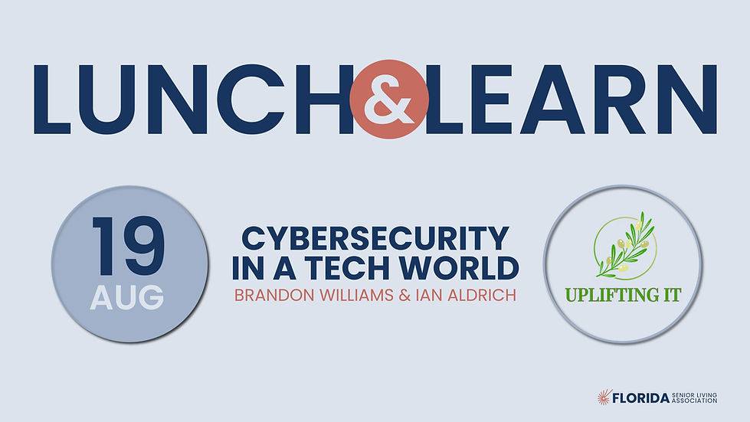

Slide 2

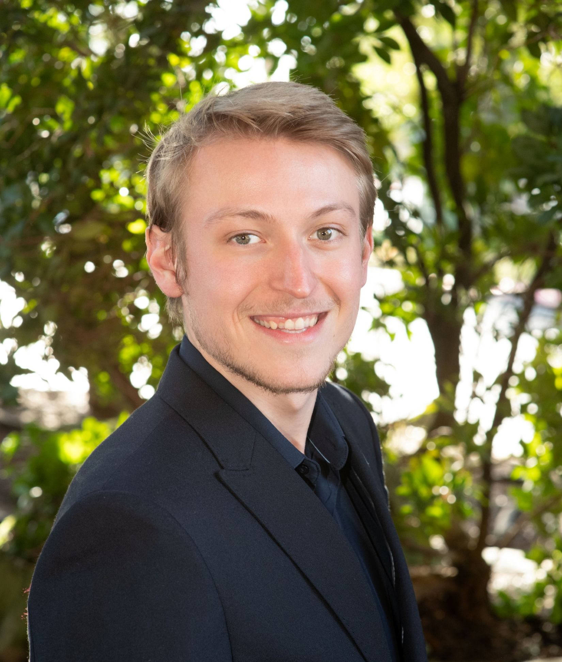
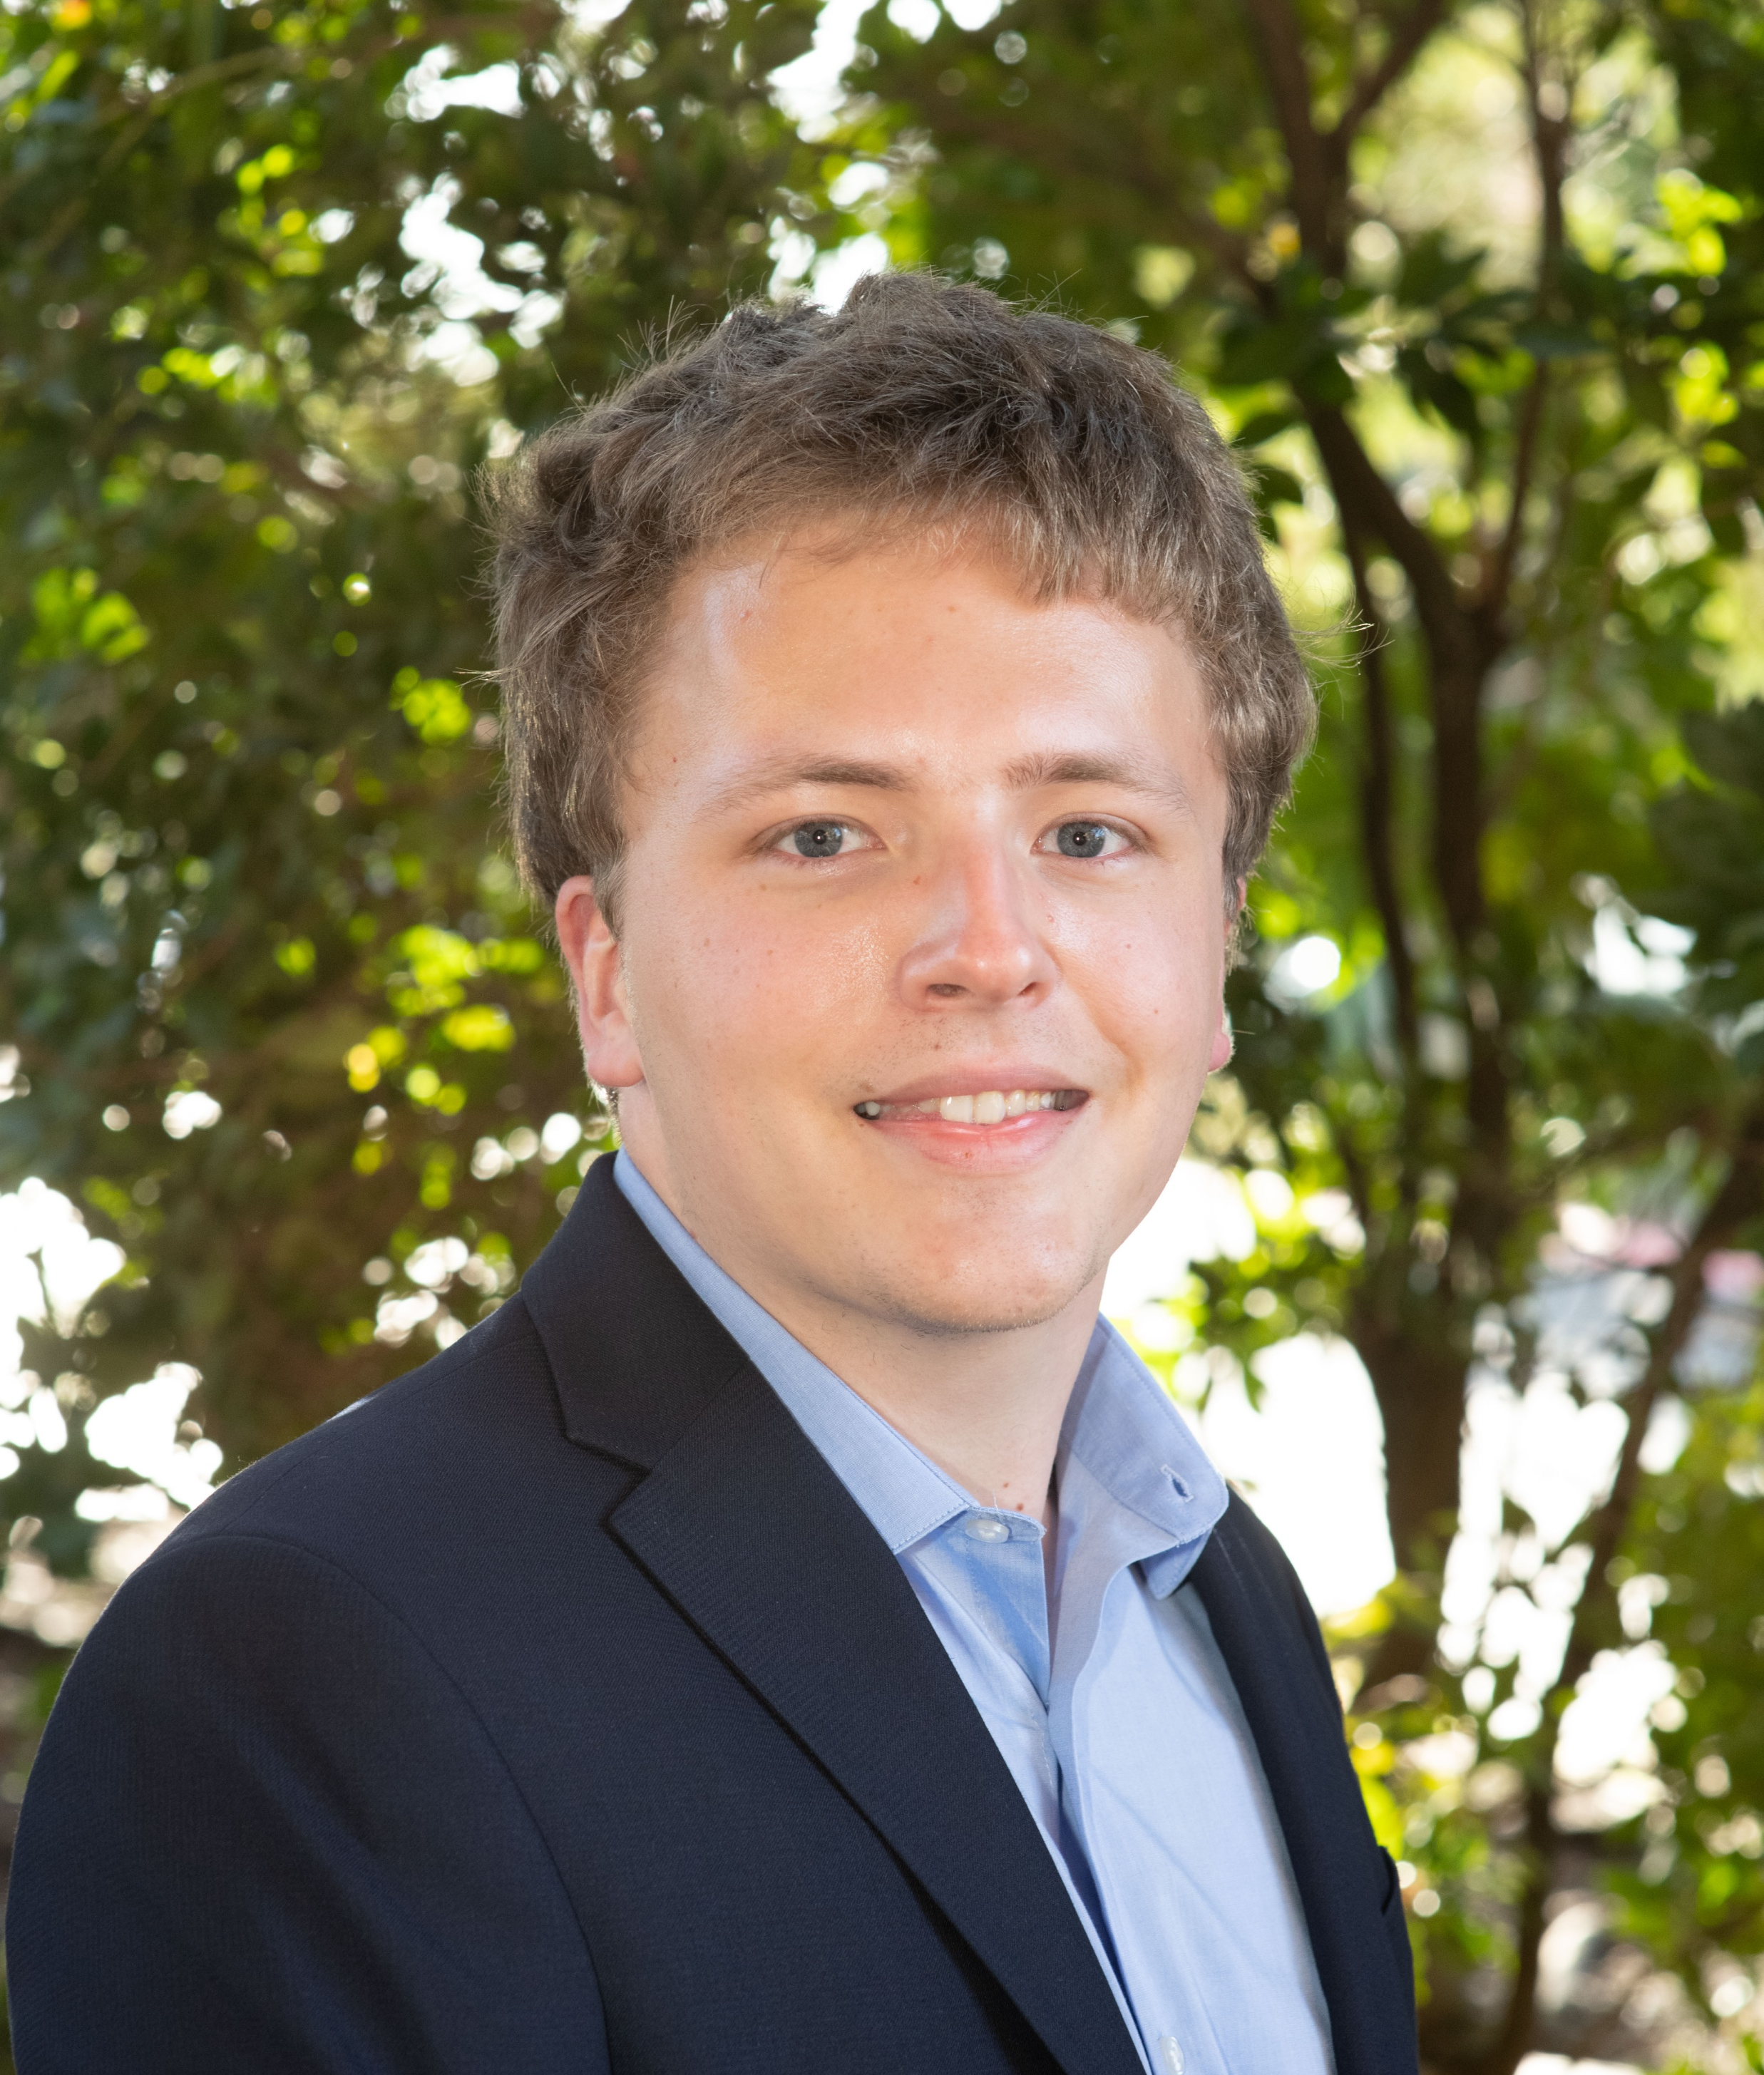
LUNCH & LEARN – CYBERSECURITY IN A TECH WORLD
Meet Your Speakers
Brandon Williams
Founder & Managing Director, UPLIFTING IT
Director of IT, ONELIFE Senior Living
Ian Aldrich
Partner & Sr IT Systems Analyst, UPLIFTING IT
Sr IT Systems Analyst, ONELIFE Senior Living

Slide 3




LUNCH & LEARN – CYBERSECURITY IN A TECH WORLD
What’s Ahead
The Financial Side
Your Personal Side
The Operational Side
Checklist
Q&A
THE THREAT
What was wrong.
THE COST
What was the impact.
WHAT YOU CAN DO
What to do from now on.

Slide 4
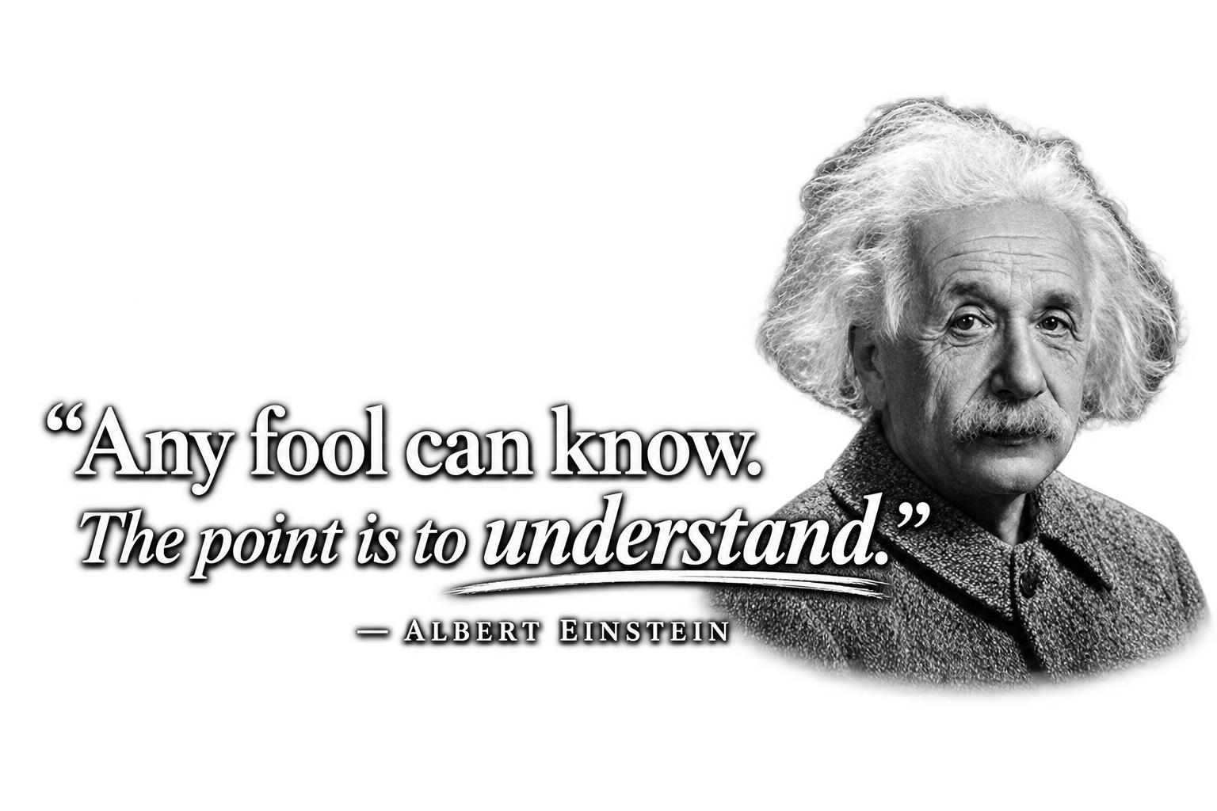
LUNCH & LEARN – CYBERSECURITY IN A TECH WORLD
First Things First
Get the most out of this!
This is an informational session – use it as one and have a hunger for knowledge
Notice where your operations are lacking, and do something about it
  Take notes of things that stand out

Slide 5
The Financial Side – Section I
The financial impact and considerations are at the heart of cybersecurity and ultimately play a role in every step of the decision-making process.

Slide 6
SECTION I · THE FINANCIAL SIDE · 01
Case Studies & Incidents
Approach these topics appropriately:
Be aware of what exists
Care about the details
Recognize the importance of cybersecurity
THE THREAT
Everyone is a target for hackers – they do not discriminate by industry or income.
THE COST
More than the potential – and often steep – financial costs that are associated with cyberattacks, there are deeper wounds that may take longer to heal: reputation, staffing, and policy revisions.
WHAT YOU CAN DO
Be proactive. Notice what went wrong in other scenarios and implement the appropriate measures before it is too late.

Slide 7
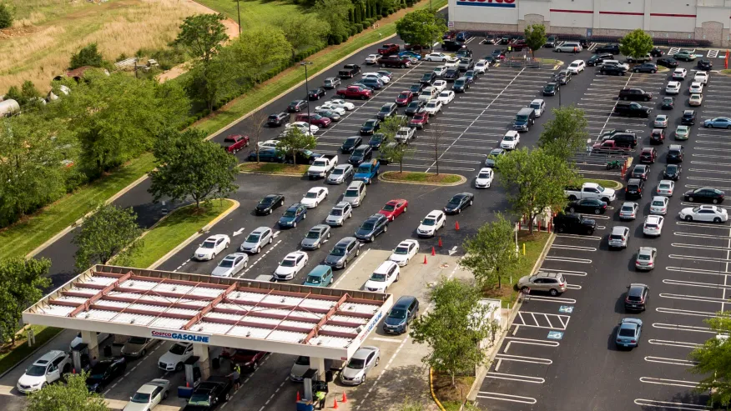
SECTION I · THE FINANCIAL SIDE · 01 – Case Studies & Incidents
Case Study #1: Colonial Pipeline
Why is it important and what was it?
The largest & most societally impactful cyber attack in United States history
45% of the East Coast’s fuel supply halted from May 7th – 12th, 2021
What happen?
Hackers gained access to a VPN account that
allowed them to push out ransomware to multiple
computers & servers
The VPN account was only secured by a username
and password

Slide 8
SECTION I · THE FINANCIAL SIDE · 01 – Case Studies & Incidents
Case Study #2: National Senior Living Operator
(Operator of 120+ Communities)
Why is it important and what was it?
The only target was employee email addresses
  Ransomware or viruses aren’t needed for damage to be caused
Several employee email accounts were compromised and accessed between September 5th – 11th, 2024
  Though, the entry method is not publicly known
What happened?
Unauthorized access was identified on September 16th, 2024
Emails were determined to have contained sensitive data of both staff and residents, including:
  SSNs, financial accounts, medical information, and other identifiable information
Over 10,000 impacted individuals

Slide 9
SECTION I · THE FINANCIAL SIDE · 01 – Case Studies & Incidents
Case Study #3: Regional Senior Living Operator
(Operator of 50+ Communities)
Why is it important and what was it?
Our industry is a target too
Attackers were a cybercriminal organization: WorldLeaks
  WorldLeaks is also responsible for hacking Nike, the City of Los Angeles, and the largest nuclear power plant in India
Maintained access from July 27th – August 15th, 2025
What happened?
Intrusion was detected on August 15th, and all systems were promptly secured along with initiating an investigation
WorldLeaks published stolen data in September 2025
5,000 impacted individuals

Slide 10
SECTION I · THE FINANCIAL SIDE · 01 – Case Studies & Incidents
Case Study #4: Local Senior Care Provider
(Locally owned & operated in San Diego, CA)
Why is it important and what was it?
The target was a locally owned Home Care & Home Health service provider
  Cyberattacks aren’t only for the big players
Attackers were a cybercriminal group specialized in small-medium businesses: Sinobi
  They primarily perform “data exfiltration” tactics
What happened?
Suspicious activity was noticed in their networks on December 8th, 2025 – the same day of entry
Sinobi stated that the ransom had not been paid, and released the data on January 5th, 2026

Slide 11
SECTION I · THE FINANCIAL SIDE · 01 – Case Studies & Incidents
Incidents
What is a “cyber incident”?
Any event that threatens confidentiality, integrity, availability, or current security measures of operational technology
Digital Cyber Incidents
Example: Employee email gets compromised
Physical Cyber Incidents
Example: Resident accessing a network room
THE THREAT
The incident itself – this is the threat, and it is crucial to identify them quickly.
THE COST
An incident is the root of any cyberattack – once an incident occurs, the potential for what follows can grow rapidly.
WHAT YOU CAN DO
Be well-versed in what an incident is. This way, you can recognize and respond that much quicker.

Slide 12

Quick Check
Which of the following are examples of a cyber incident?
Select all that apply.
A
You notice a new email rule that you didn’t create forwards all your emails to an unknown email address.
B
The network room key always gets stuck, so you decide to leave the room always unlocked.
C
You downloaded a free movie off the internet, and suddenly your whole computer turns blue with a message box saying, “Call this number to get your data back”.
D
You can’t find that one email that you know you have from last week and urgently need. So, you start wondering if your dog’s best friend’s owner’s neighbor’s cousin’s brother Timmy could’ve hacked your email. Only to find it was accidentally moved into the wrong folder all along.

Slide 13
Quick Check
Which of the following are examples of a cyber incident?
Select all that apply.
A
You notice a new email rule that you didn’t create forwards all your emails to an unknown email address.
B
The network room key always gets stuck, so you decide to leave the room always unlocked.
C
You downloaded a free movie off the internet, and suddenly your whole computer turns blue with a message box saying, “Call this number to get your data back”.
D
You can’t find that one email that you know you have from last week and urgently need. So, you start wondering if your dog’s best friend’s owner’s neighbor’s cousin’s brother Timmy could’ve hacked your email. Only to find it was accidentally moved into the wrong folder all along.

Slide 14

SECTION I · THE FINANCIAL SIDE · 02
Cyber Insurance
The most important aspect of cybersecurity
You should always do your best to be secure, but you can never be perfect
Much more than an insurance policy
It is risk management
Two key points:
Do you have cyber insurance?
If you do have it, are you sure you’re covered?
(AKA – Are you compliant with your cyber insurance?)
THE THREAT
Missing or non-compliant cyber insurance leaves an organization completely financially liable for whatever the outcome of a cyberattack may be.
THE COST
Between 2020-2024 (SMEs):
Average cyber insurance payout: $183,000
Average cyber incident cost: $264,000
Source: NetDiligence®, 2025 Cyber Claims Study, 2020–2024 claims data.
WHAT YOU CAN DO
Verify that your cyber insurance has been reviewed by the appropriate people and that you are compliant with it.

Slide 15
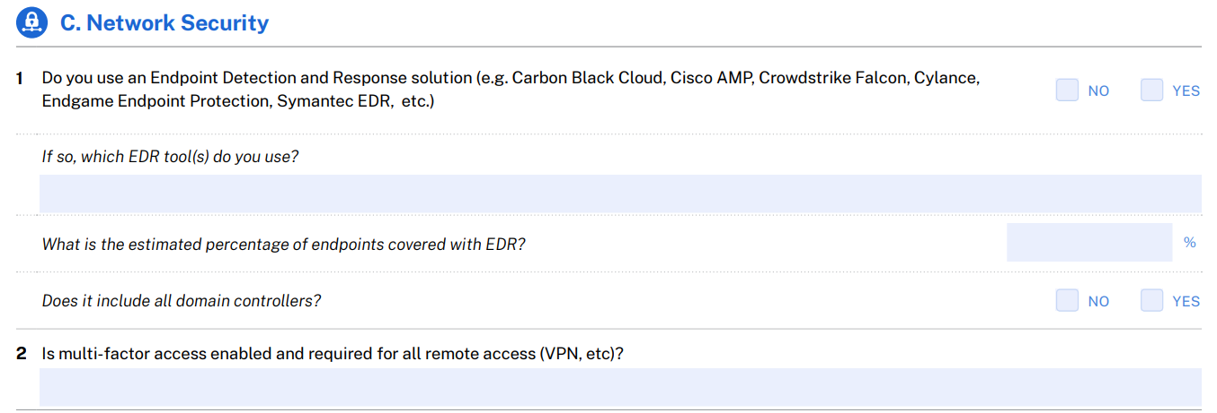
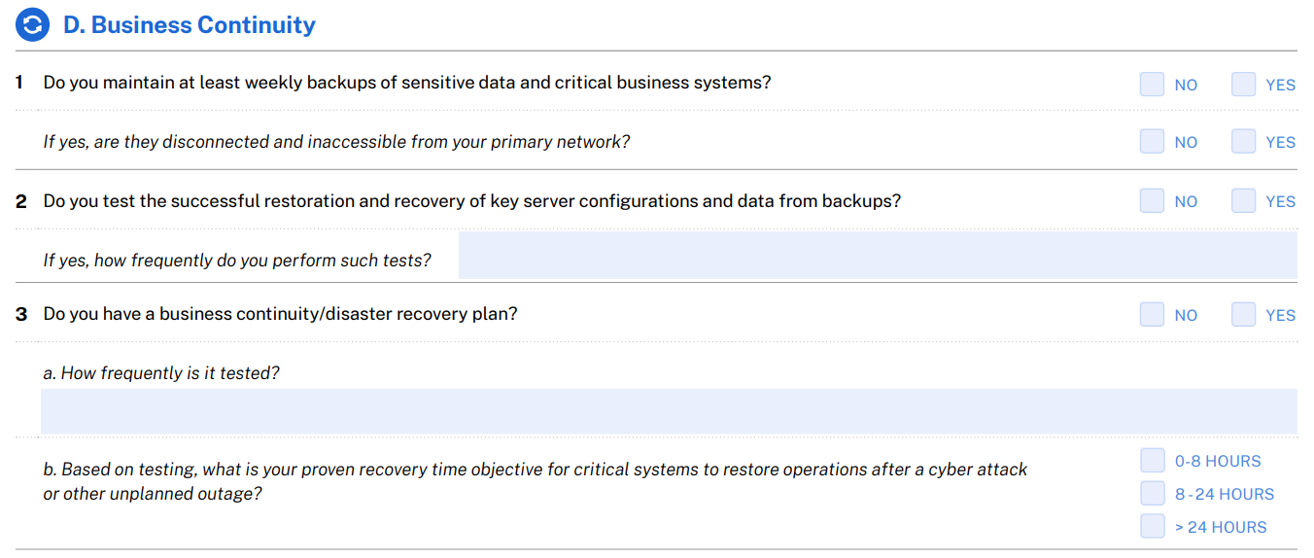
SECTION I · THE FINANCIAL SIDE · 02 – CYBER INSURANCE
Being Compliant With Cyber Insurance
Are you just checking boxes?
Cyber insurance questionnaires are highly technical and require precise, accurate answers
Without accuracy, your policy may be nothing but a piece of paper

Slide 16
SECTION I · THE FINANCIAL SIDE · 02 – CYBER INSURANCE

Slide 17
SECTION I · THE FINANCIAL SIDE · 02 – CYBER INSURANCE
Being Compliant With Cyber Insurance
Are you just checking boxes?
Cyber insurance questionnaires are highly technical and require precise, accurate answers
Without accuracy, your policy may be nothing but a piece of paper

Slide 18
SECTION I · THE FINANCIAL SIDE · 02 – CYBER INSURANCE

Slide 19
SECTION I · THE FINANCIAL SIDE · 02 – CYBER INSURANCE
Lowering Your Premiums
Main concept for lowering premiums
The more you manage your risk → The lower your premiums are
Practical methods
Conduct cybersecurity audits
  Internal audits
  External audits (sometimes legally required)
Have internal documentation for:
  Audits conducted
  Security reviews
  Access control changes
  Backup verifications
THE THREAT
Wasteful spending
High premiums = High risk profile
(Normally)
THE COST
Financial impacts are ultimately felt across all departmental budgets.
WHAT YOU CAN DO
Ensure cybersecurity audits are being conducted and that measures taken are well documented.

Slide 20

Your Personal Side – Section II
Most incidents in senior living do not start with a hacked firewall. They start with one email, one click, or one paste into the wrong tool.

Slide 21
SECTION II · YOUR PERSONAL SIDE · 01
Phishing
What fake emails look like now
The sender address is one letter off from a real vendor or coworker
Always urgent: “Your password expires today”
Fake invoices, fake DocuSign links, fake Microsoft login pages
A vendor changing their bank info right before a payment
Tell every employee this
Stop, check, report
Call using a number you already have. Never the one in the email.
Never approve a login request on your phone if you did not start it
Nobody gets in trouble for reporting. Thank the person who clicked.
THE THREAT
Fake emails that steal staff passwords or reroute a payment. They target your people, not your firewall.
THE COST
One convincing email can misdirect a real payment or hand over a password that unlocks everything it touches. BEC scams cost U.S. victims $3.05B in 2025 alone.
WHAT YOU CAN DO
Train staff with practice phishing emails, add a Report Phishing button, turn on multi-factor login, and put the no-blame rule in writing.

Slide 22
SECTION II · YOUR PERSONAL SIDE · 01
Real-World Examples
STATE DHS · 2019
LONG-TERM CARE FACILITY
One phishing email, statewide fallout
A fake vendor invoice
645,000+
$108,000
State resident records exposed, including elderly and disabled clients in state care programs
wired to attackers during a facility repair project
Nine employees at the State's Department of Human Services clicked one phishing email
It compromised mailboxes holding nearly 2 million emails
Exposed names, SSNs, dates of birth, and case numbers
Attackers impersonated a contractor’s email during an active repair project
Sent a fake invoice with new payment and routing instructions
The facility paid before anyone confirmed the change by phone
LESSON One click, by one employee, can compromise records for hundreds of thousands of the people you serve.
LESSON Always confirm new banking details by phone. Use a number you already have, never the one in the email.
Source: Becker’s Hospital Review.
Source: McKnight’s Long-Term Care News.

Slide 23

SECTION II · YOUR PERSONAL SIDE · 02
Email Encryption
Encrypt anything with
Resident health info, care notes, and resident lists
SSNs, Medicare and insurance numbers, payment info
Payroll, HR, and banking info
Anything a vendor, pharmacy, or family sends about a resident
Encryption is not the whole answer
It does not help if the email goes to the wrong person. That is still a reportable breach.
Autocomplete picking the wrong name is the usual cause
Read the “To” line last, every time. Check the attachment too.
Your inbox is not a filing cabinet. Old attachments are what make a breach big.
THE THREAT
Resident and employee info sent in plain text or encrypted correctly and sent to the wrong person.
THE COST
One misdirected email with health info is a reportable breach: notification, investigation, and regulators, for one wrong click. Compromised email accounts were tied to roughly 1 in 4 large healthcare breaches reported in 2025.
WHAT YOU CAN DO
Turn on automatic encryption for health and financial info, train staff to check the To line and the attachment and set a rule for how long email is kept.

Slide 24

SECTION II · YOUR PERSONAL SIDE · 03
AI Usage: Set the Rules First
Your staff already use AI, whether it is approved or not
A one-page policy answers four things: who can use it, for what, with what info, and who to ask when unsure
Never put this into any AI tool
Resident names, room numbers, photos, health info, medication lists
SSNs, insurance and Medicare numbers, financials, employee records
Use it the right way
Use approved tools on company accounts. Business accounts usually keep your data out of training, but free personal ones might not.
If a tool touches health info, get a signed BAA. A "HIPAA compliant" claim on a website is just marketing, not a real contract.
Good uses: job posts, marketing copy, policy drafts, agendas. Just take the names out first.
THE THREAT
Staff pasting resident health info, financials, or employee records into AI tools nobody approved or signed a contract with.
THE COST
Information you cannot pull back, a health data disclosure with no contract behind it, and no record of what left the building.
WHAT YOU CAN DO
Write a one-page AI policy naming approved tools and off-limits info, pay for business accounts, and require a signed BAA before any AI tool touches health info.

Slide 25

SECTION II · YOUR PERSONAL SIDE · 04
AI Usage: When It Goes Wrong
ChatGPT share links, 2025
A checkbox let shared chats show up in Google search results
Thousands were found, some with real names and confidential work documents
OpenAI pulled the feature in August 2025, but deleting a chat does not delete an old share link that is already indexed
Samsung, 2023
Engineers pasted company source code into ChatGPT to help debug it
Samsung banned the tool internally after the leak
The takeaway
Nobody got hacked in either story. Staff pasted, and staff shared.
Once it is out, you cannot take it back or find out who saw it
AI also sounds very confident when it is wrong
THE THREAT
Information walking out the front door. Pasted into a chat, shared as a public link, or trusted without anyone checking it.
THE COST
Private information sitting on the public internet with no way to take it back, no record, and no idea who read it.
WHAT YOU CAN DO
Teach staff that share links are public web pages, review share and history settings on approved tools, and have a person review AI output before it reaches a record or a regulator.

Slide 26
Quick Check
Maria in billing pastes a resident’s discharge summary into a free AI chatbot to help write a family update email. What’s the biggest problem?
A
The email will probably sound a little robotic
B
The free tool may train on that data, and there is no signed BAA protecting the resident’s health information
C
It will take longer than typing it herself
D
There is no problem, as long as she deletes the chat afterward

Slide 27
Quick Check
Maria in billing pastes a resident’s discharge summary into a free AI chatbot to help write a family update email. What’s the biggest problem?
A
The email will probably sound a little robotic
B
The free tool may train on that data, and there is no signed BAA protecting the resident’s health information
C
It will take longer than typing it herself
D
There is no problem, as long as she deletes the chat afterward

Slide 28

The Operational Side – Section III
Protecting the residents you serve, the devices they touch, and the network that connects every system in your building.

Slide 29

SECTION III · THE OPERATIONAL SIDE · 01
Protect Your Residents: Scams
What your residents are getting hit with
The grandchild-in-trouble call, fake bank fraud departments, fake tech support
AI voice cloning. A few seconds of audio can copy a voice.
Medicare calls about a “new card” or a free brace, worst during open enrollment
Gift cards, wire transfers, crypto, and “don’t tell anyone.” That is always a scam.
What you can build
Run short scam classes, more than once a year
Teach one habit: hang up and call back on a number you already have
Give residents one name and extension to call when something feels off
Never embarrass a resident who reports a scam. Shame is why most of it goes unreported.
THE THREAT
Fraud aimed straight at your residents. Fake family, fake banks, fake Medicare, and now cloned voices.
THE COST
Life savings, dignity, and trust in your community, plus the family conversation after they learn nobody warned anyone. Seniors nationally lost $7.75B to fraud in 2025, up 59% from the year before.
WHAT YOU CAN DO
Put resident scam classes on the calendar, post one internal number for “is this a scam,” and make it a rule that nobody gets blamed for reporting one.

Slide 30
SECTION III · THE OPERATIONAL SIDE · 01 – BY THE NUMBERS
Elder Fraud in 2025
$7.75B
+59%
201,266
$38,500
total losses reported by Americans 60+
year-over-year increase in losses
elder fraud complaints filed with the FBI
average dollar loss per victim
2025 LOSSES BY SCAM CATEGORY
AI ENABLED FRAUD
$893M+
in losses tied to AI-enabled fraud complaints in 2025 (22,000+ complaints)
A few seconds of a grandchild’s voice, pulled from social media, is enough to fake a call for help.
Source: FBI Internet Crime Complaint Center (IC3), 2025 Elder Fraud Report.

Slide 31

SECTION III · THE OPERATIONAL SIDE · 02
Protect Your Residents: Data and Devices
Keep everything updated
Community computers, tablets, kiosks, printers, cameras, and TVs
If the maker stopped supporting it, it will never get fixed again, so replace it
Shut off accounts the day someone leaves
Staff, agency and PRN, contractors, and vendors you stopped using
Email, the EHR, the pharmacy portal, remote access, shared passwords
Shared devices: sign out, clear the history, save nothing
Know where resident info actually lives
It is not only in your EHR. Think front desk spreadsheets, printed census lists, med cart printouts, sign-in sheets.
If you cannot say where resident info lives, you cannot protect it
THE THREAT
Devices nobody updates, accounts that stay open after people leave, and resident info spread across systems and paper nobody has listed.
THE COST
A former employee or an old kiosk quietly reaching live resident records, and a breach you cannot size because nobody knows where the data was.
WHAT YOU CAN DO
Put updates on a schedule, make shutting off accounts a signed step when someone leaves, and write a list of every place resident info lives, on screen and on paper.

Slide 32

SECTION III · THE OPERATIONAL SIDE · 03
Network Security and Resiliency
Your network is everything that connects
Computers, Wi-Fi, phones, cameras, door locks, TVs, med carts
A flat network is a building with every inside door propped open. Get in anywhere and you can reach everything.
Give staff, residents, guests, and building systems their own networks, wired and wireless. A hallway jack is a door too.
A resident’s infected laptop should never be able to reach resident records
Plan for the day something gets in anyway
Test your backups. A backup you have never tested is just a hope.
Keep one copy offline so ransomware cannot reach it
Write down how you will run the building on paper if the systems go down
Ask your IT provider: are our networks separated, and when did we last test a backup?
THE THREAT
One flat network where an infected guest phone, resident laptop, or old camera can reach everything, including resident records.
THE COST
One infected device taking down the whole building at once. Care systems, phones, door locks, and records.
WHAT YOU CAN DO
Separate the staff, resident, guest, and building system networks on both wired and wireless, test your backups, and write down a plan for running on paper.

Slide 33

SECTION III · THE OPERATIONAL SIDE · 03 – CASE STUDY
Ransomware at a Senior Care Provider
UTAH · JANUARY TO FEBRUARY 2026
WHAT WOULD HAVE HELPED STOP THIS
Skilled nursing & home health provider
What happened
Attackers gained unauthorized access to the network
The Qilin ransomware group claimed responsibility and threatened to publish stolen data
A review was launched to determine whether protected health information was exposed
Qilin claimed 40+ new victims a month across all sectors... more than any other ransomware group tracked, with healthcare a frequent target.
Why long-term care is a target
Small IT budgets and small IT teams
Care systems that run around the clock and are hard to shut off
Resident data that is valuable and hard to replace
Offline backups that ransomware cannot reach or lock up
Multi-factor login on everything, not just email
Splitting up the network so one infected system cannot spread to the rest
A tested plan for what to do, with a paper backup you can run without computers
Source: Qilin ransomware group claim; industry reporting.

Slide 34
Quick Check
Your facility’s guest Wi-Fi and your EHR sit on the same flat network. A visitor’s laptop picks up malware in the parking lot and connects inside. What is the most effective fix discussed today?
A
Change the Wi-Fi password every month
B
Separate networks for staff, residents, guests, and building systems (segmentation)
C
Ask the visitor to reconnect later in the day
D
Install antivirus only on the front desk computer

Slide 35
Quick Check
Your facility’s guest Wi-Fi and your EHR sit on the same flat network. A visitor’s laptop picks up malware in the parking lot and connects inside. What is the most effective fix discussed today?
A
Change the Wi-Fi password every month
B
Separate networks for staff, residents, guests, and building systems (segmentation)
C
Ask the visitor to reconnect later in the day
D
Install antivirus only on the front desk computer

Slide 36
SECTION III · THE OPERATIONAL SIDE · 04
Setting Configurations
A large portion of cybersecurity is pushing the right buttons on a settings page
You may not be the one configuring it, but you and all people whose data you can access is relying on it
Are you confident that your settings are configured properly?
Are you confident that your settings are configured properly?
Let’s test your confidence
THE THREAT
A single misconfigured setting is an open door. The more doors that are open, the more likely you are to be compromised.
THE COST
Portions of systems or even entire networks can be compromised due to weak security posture.
WHAT YOU CAN DO
Ensure with the appropriate people that the settings used to secure your software and devices undergo in-depth security reviews.

Slide 37
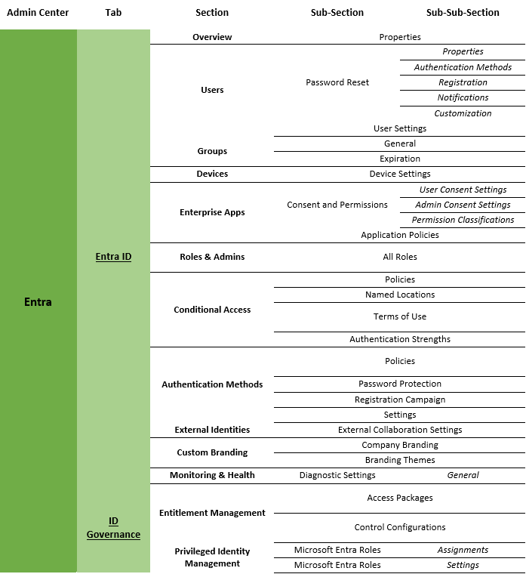
SECTION III · THE OPERATIONAL SIDE · 04 – SETTING CONFIGURATIONS
Configuring Microsoft Windows
Have Windows computers in your organization?
If so, then those devices are most likely managed by Microsoft’s Admin Centers
There are thousands of settings across Microsoft’s Admin Centers
These settings are what you must trust is configured correctly and reviewed regularly

Slide 38
SECTION III · THE OPERATIONAL SIDE · 04 – SETTING CONFIGURATIONS · CONFIGURING MICROSOFT WINDOWS

Slide 39
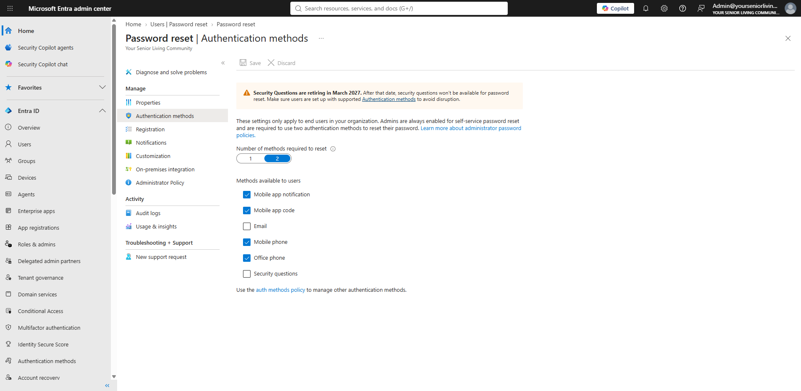
SECTION III · THE OPERATIONAL SIDE · 04 – SETTING CONFIGURATIONS · CONFIGURING MICROSOFT WINDOWS

Slide 41
SECTION III · THE OPERATIONAL SIDE · 04 – SETTING CONFIGURATIONS · CONFIGURING MICROSOFT WINDOWS

Slide 42
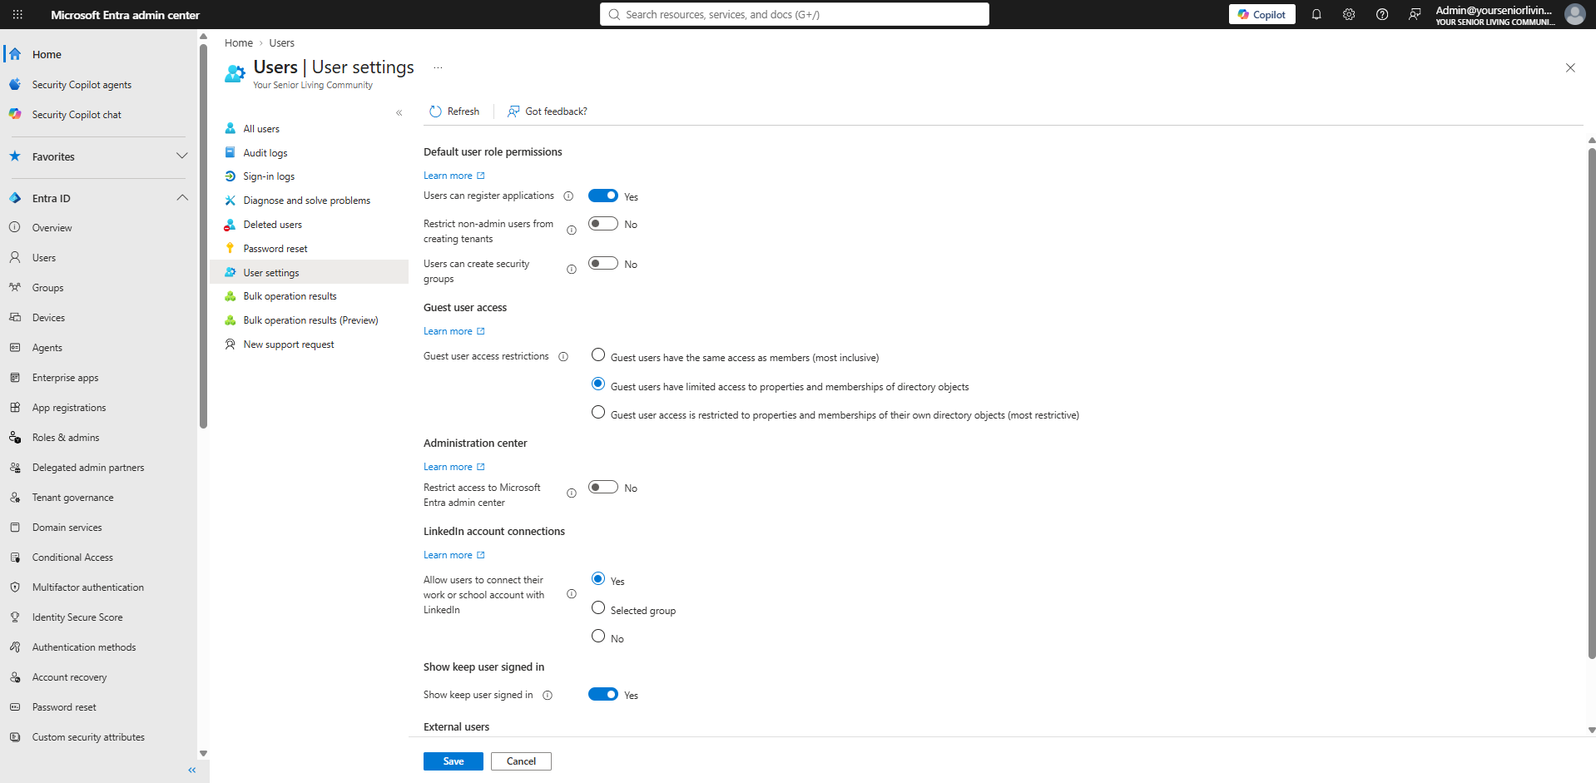
SECTION III · THE OPERATIONAL SIDE · 04 – SETTING CONFIGURATIONS · CONFIGURING MICROSOFT WINDOWS

Slide 44
SECTION III · THE OPERATIONAL SIDE · 04 – SETTING CONFIGURATIONS · CONFIGURING MICROSOFT WINDOWS
4

Slide 45
SECTION III · THE OPERATIONAL SIDE · 04 – SETTING CONFIGURATIONS · CONFIGURING MICROSOFT WINDOWS
4

Slide 46
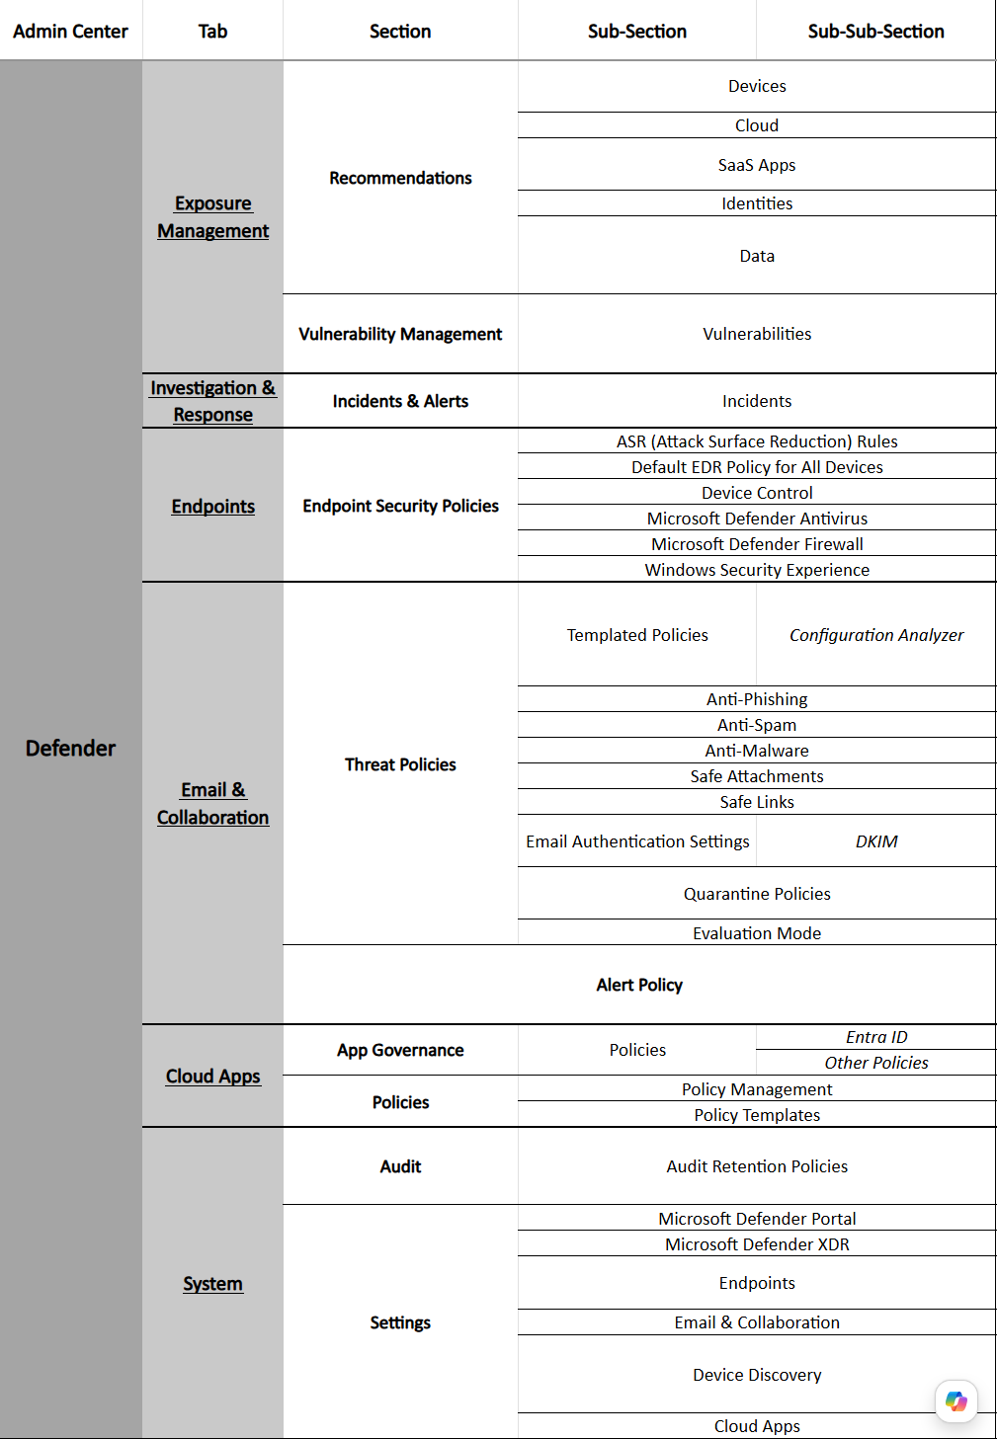
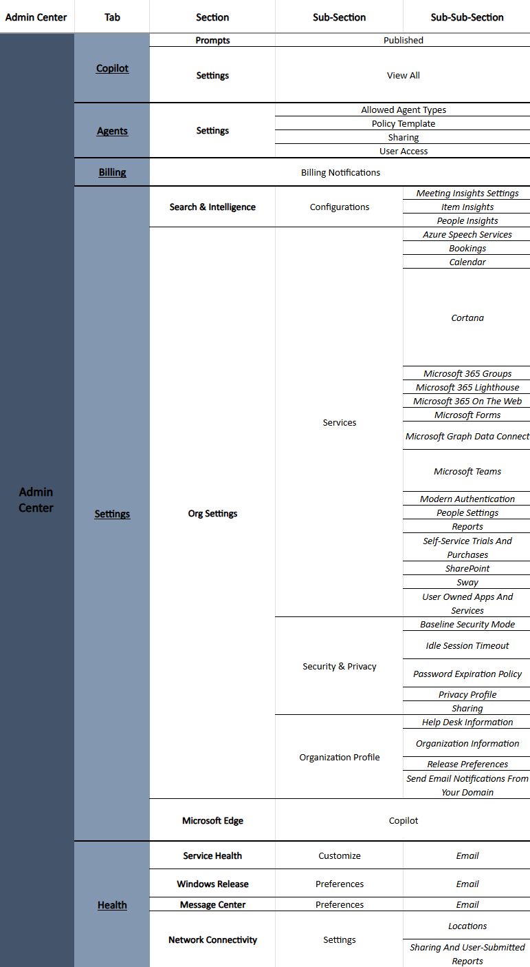
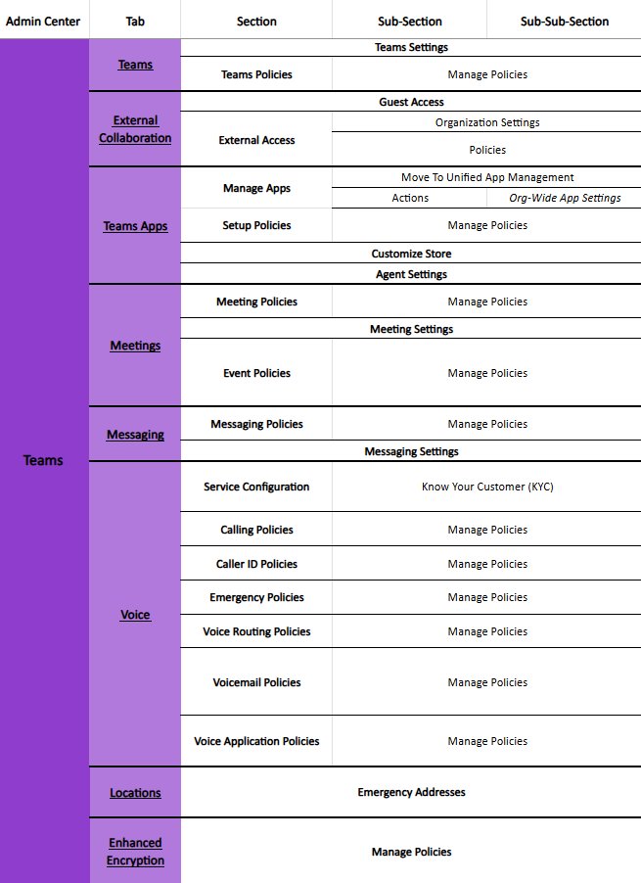
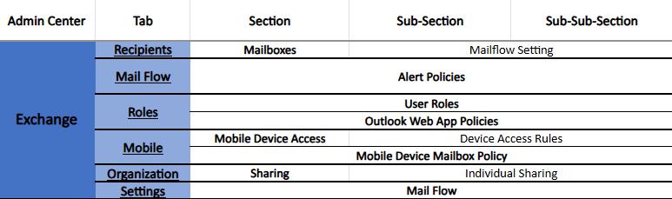
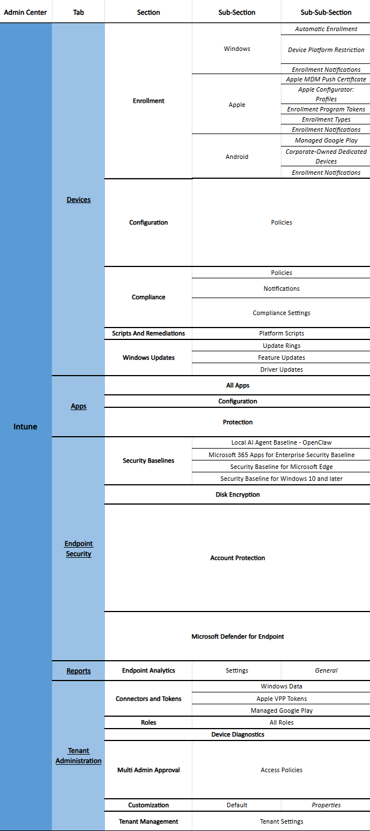
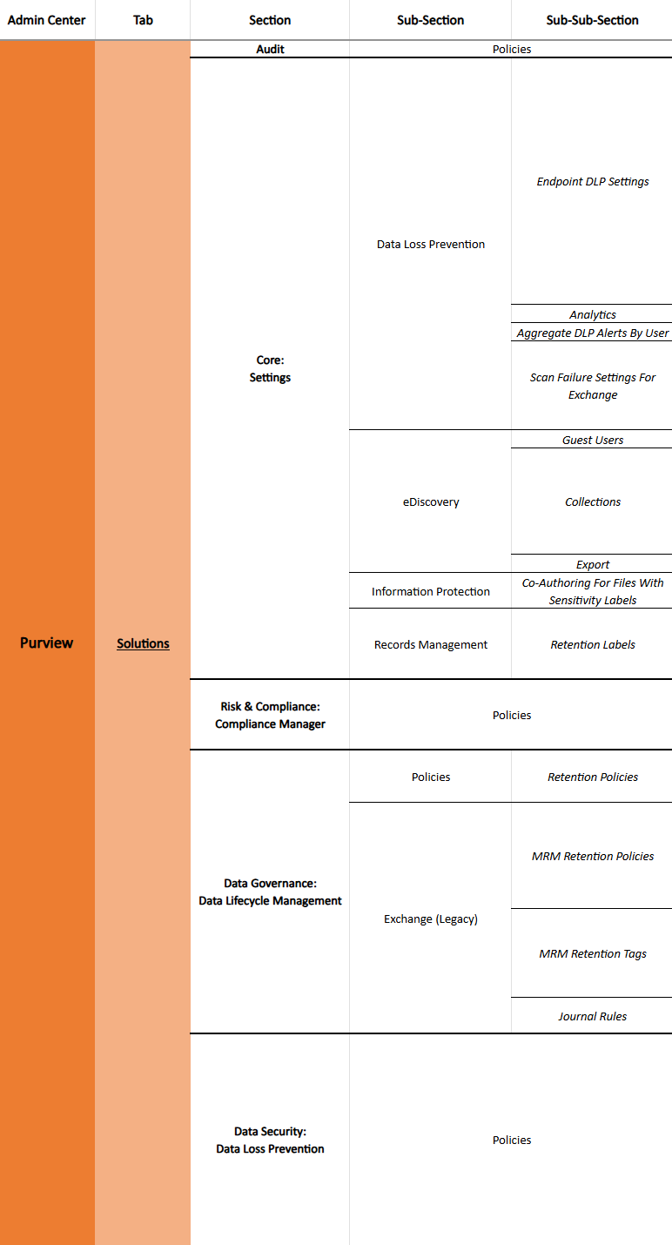
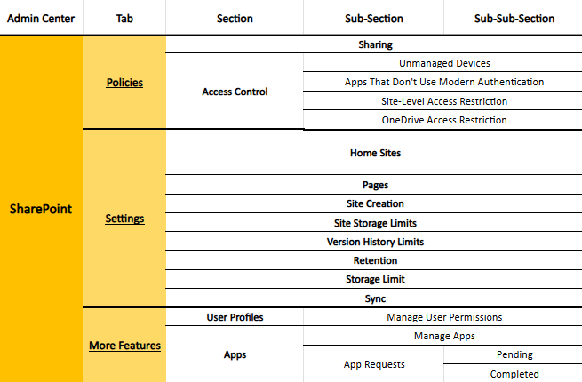

Slide 47
FREE RESOURCE DOWNLOAD AT THE END

Slide 48
SECTION III · THE OPERATIONAL SIDE · 04 – SETTING CONFIGURATIONS
Configuring Other Software
It doesn’t stop at Microsoft
If you can access it, then it’s a target
What software or services do you use that needs to be configured securely?
Phone Systems
Nurse Call System Access
Financial Applications (QuickBooks, Yardi, etc.)
EHR/EMR
CRMs
Family Connection Software
Activities Software
AI Platforms
…

Slide 49
SECTION III · THE OPERATIONAL SIDE · 05
Security Shouldn’t Be Intrusive
Cybersecurity engineers can get “tunnel vision”
It is easy to over-secure a network
  Example: Block every website and only allow the “needed ones”
Respectfully voice your concerns
Cybersecurity folks may be amazing at what they do, but you know the operational reality better
  Find compromises that satisfy both security concerns and operational realities
THE THREAT
Oversecured systems poses great inefficiencies in a realistic operational environment.
THE COST
All the efficiencies gained by technology can feel as if they are dwindling away if security measures wall you in.
WHAT YOU CAN DO
Voice concerns over operational inefficiencies that are being explained away as “security measures” – see if a compromise can be found.

Slide 50
SECTION III · THE OPERATIONAL SIDE · 06
Have a Dedicated IT/Cyber Person or Department
(Straightforward Warning)
There is no one that can wear an IT/Cyber hat along with any other hats
Your culinary/maintenance/housekeeping person – or sometimes all of the above – is not an IT person
To do so is an insult to those a community serves
  That doesn’t mean there aren’t good intentions, there just needs to be the right execution
IT/Cybersecurity requires full-time effort
Can everything we’ve covered here be adequately covered by someone stretched between roles?
If you have a dedicated IT/Cyber person or department, is it enough?
THE THREAT
Wearing “IT” as one of someone’s many hats yields numerous overlooked and underserved areas of cybersecurity.
THE COST
The community is left vulnerable and liable for the great number of attackers that are waiting at the gate.
WHAT YOU CAN DO
Ensure that your IT needs are being met – both visible and invisible needs.
Uncover invisible needs that are being overlooked by getting a third-party audit.

Slide 51
SECTION III · THE OPERATIONAL SIDE · 06
Anticipating Emerging Threats
Artificial Intelligence
AI may be who hacks you next
  OpenAI’s model accidentally, autonomously hacked a competitor in July 2026
  Taiwanese State Infrastructure & Nuclear Safety Agency hacked by autonomous AI agents
    Compromised 85 government user accounts, 21 government IT systems, and 2,500 personnel records
Quantum Computers
Notorious “Q-Day”
  The day encryption falls
Other theoretical cybersecurity risks are constantly surfacing
THE THREAT
The future holds many possibilities – without being prepared for it, you risk vulnerabilities multiplying as time goes on.
THE COST
Previously iron-clad, well-protected systems fall to the test of time and new cyberattack techniques.
WHAT YOU CAN DO
Ensure that someone in your organization is staying vigilant in researching and preparing all systems for what may come next.

Slide 52
CYBERSECURITY READINESS CHECKLIST
Checklist

Slide 53


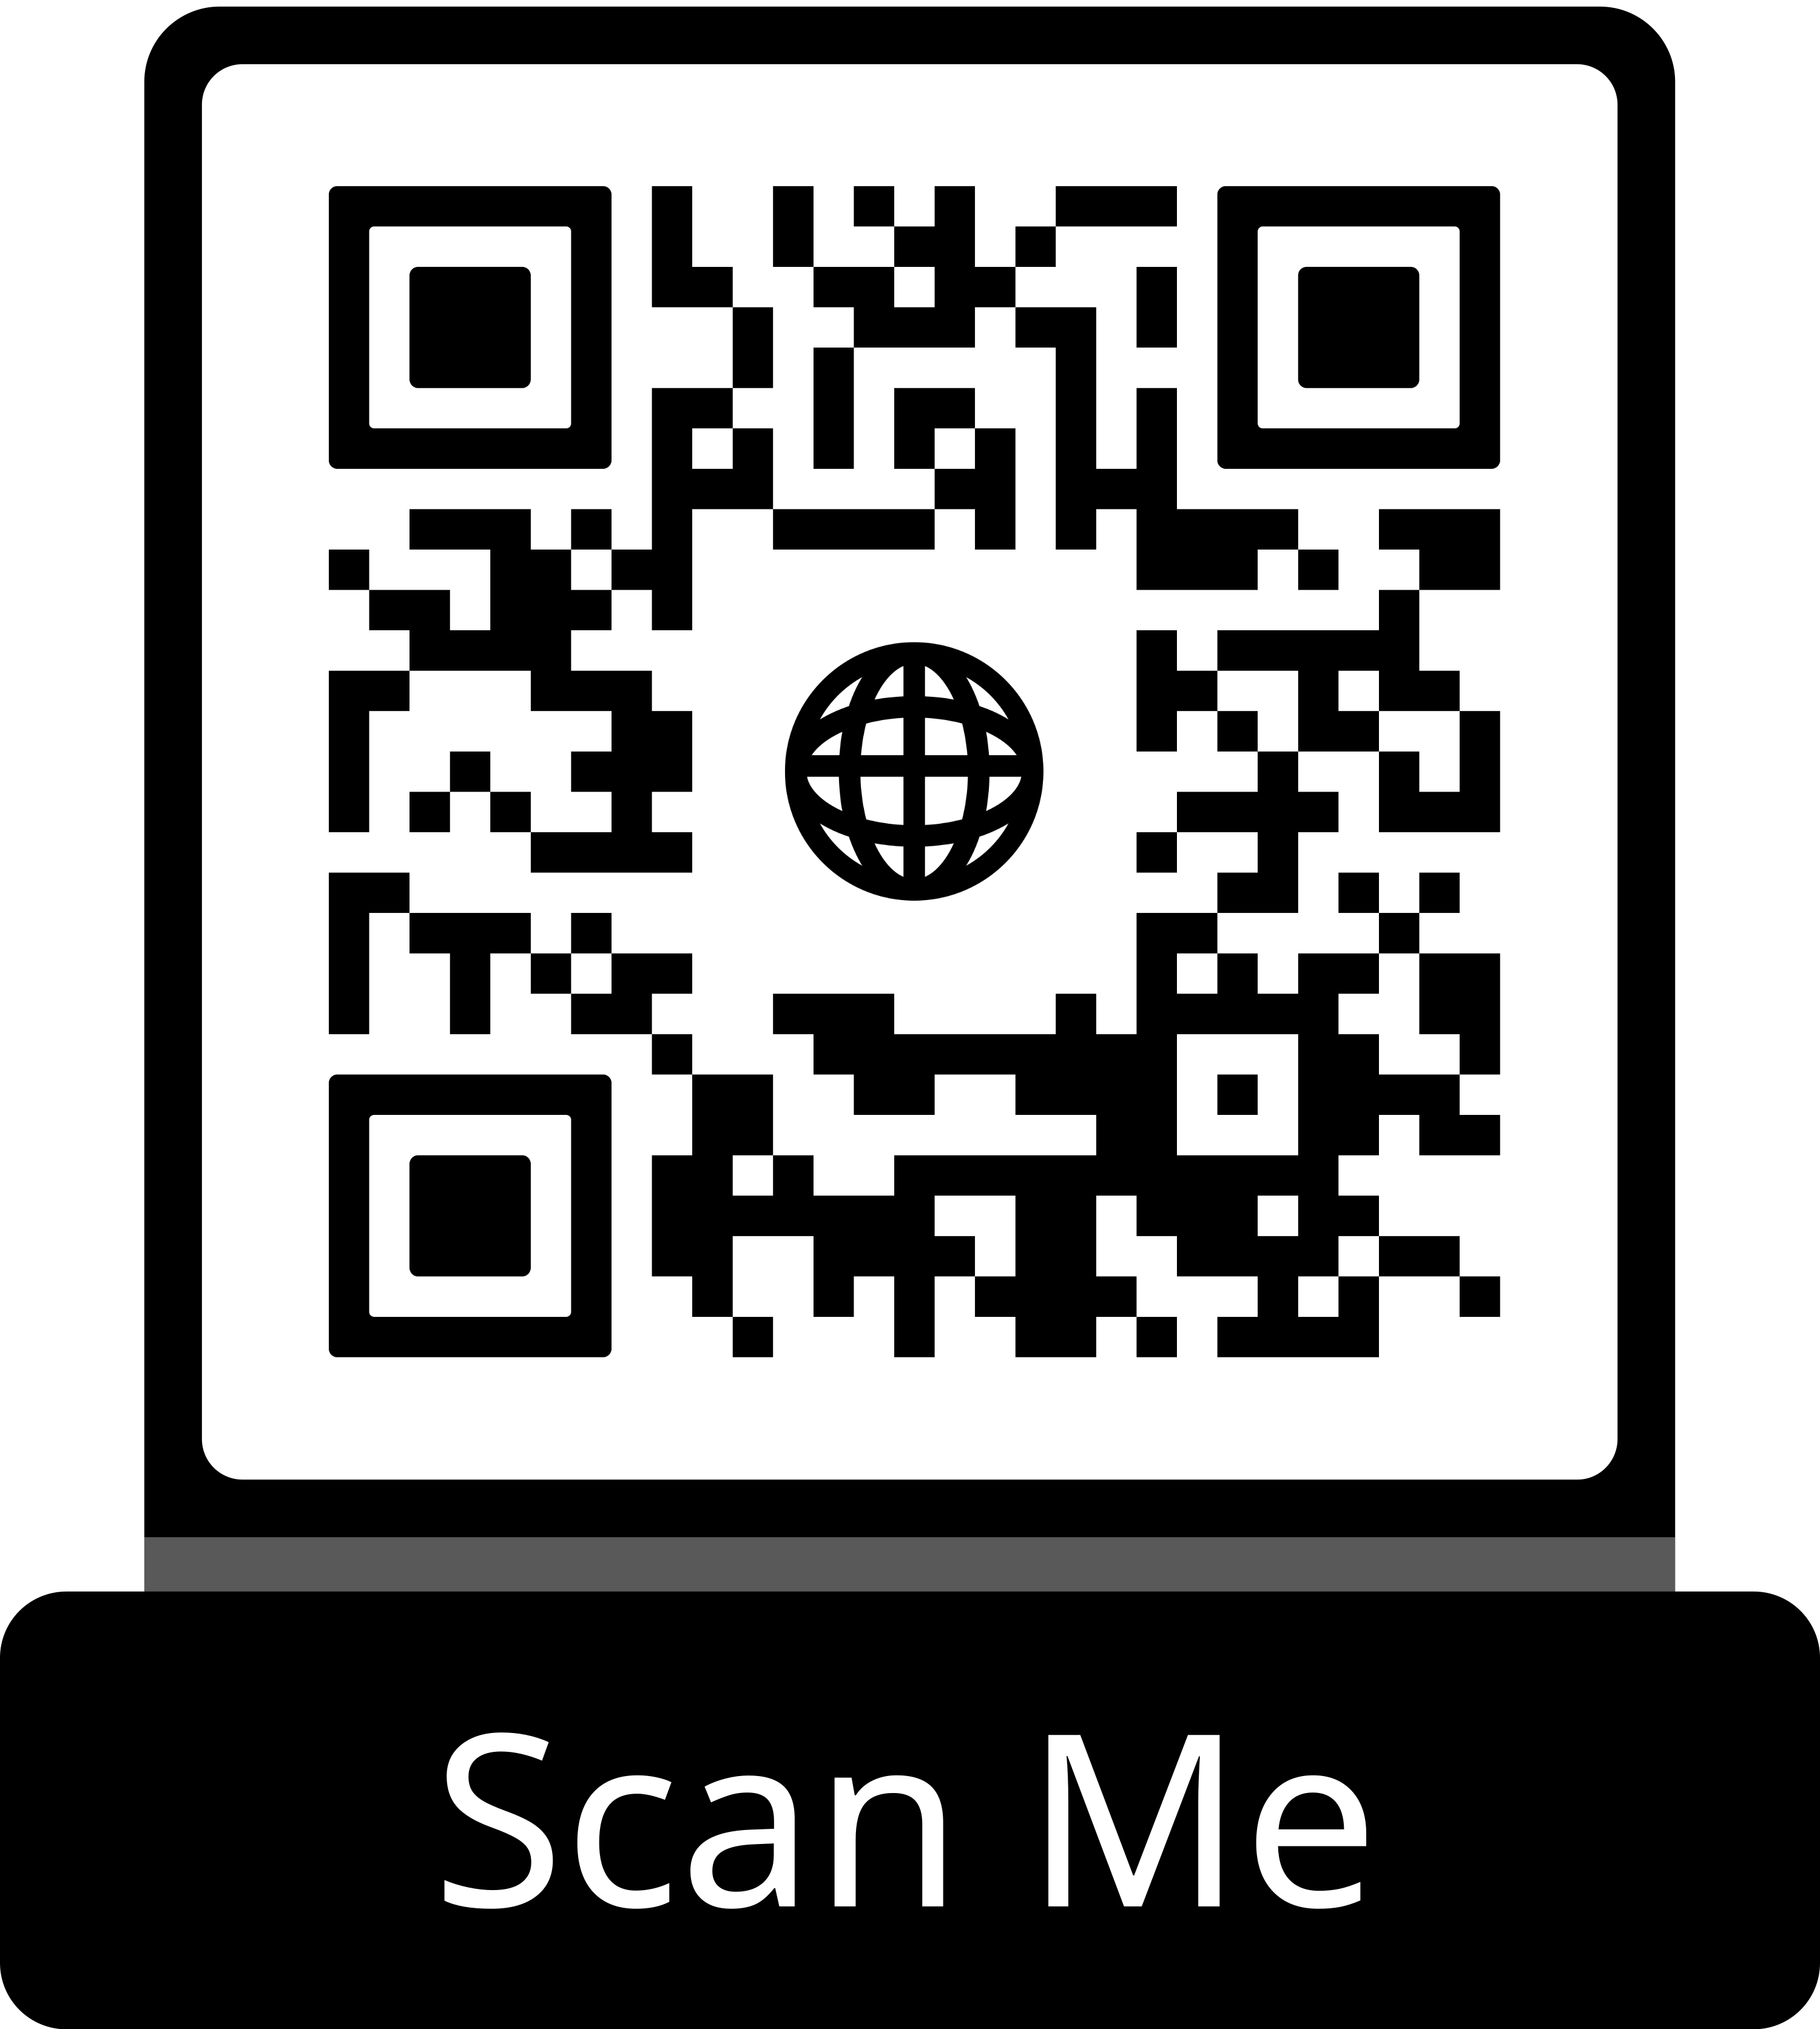
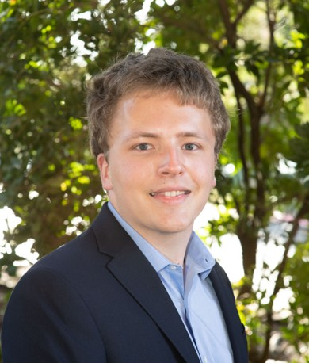

THANK YOU – ANY QUESTIONS?
Brandon Williams
Founder & Managing Director, UPLIFTING IT
Director of IT, ONELIFE Senior Living
brandon@upliftingit.com
Resources
Ian Aldrich
Partner & Sr Systems IT Analyst, UPLIFTING IT
Sr Systems IT Analyst, ONELIFE Senior Living
ian@upliftingit.com
Cybersecurity Readiness Checklist · Microsoft Admin Center Review Spreadsheet · Lunch & Leam Presentation
Thank you for protecting the people in your care.

